Slide 1

Require.js Module Loader

Slide 2
Table of Content
Understanding how HTML page in Rendered
Understanding Problems associated with Large Scale Applications
JavaScript Module Pattern
What is Require.js
Loading Modules with “Require”
Creating Modules
Resolving Problems with Require.js
Other Module Loaders
Optimization using Require.js
Configuring Require.js

Slide 3
Browser Parsing

Slide 4
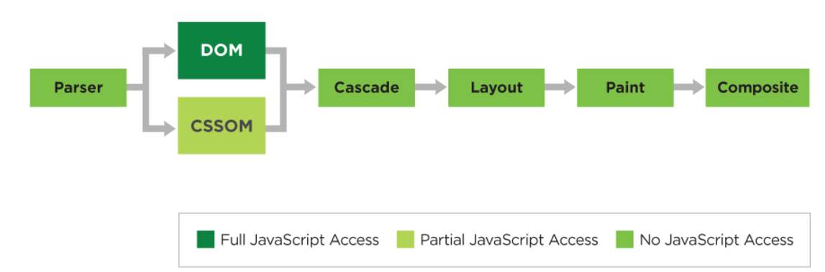
HTML Page Processing

Slide 5
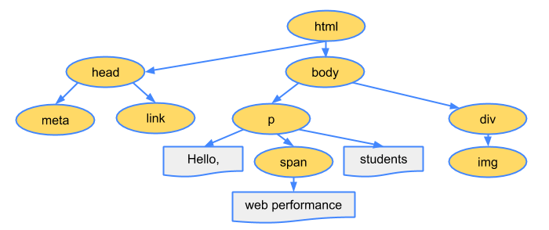
DOM Parsing
Following steps are involved:
Browser reads the raw HTML bytes
String of characters are converted to distinct tokens
Tokens are then converted in DOM Object
Rules and properties are defined for DOM Objects
DOM Objects are linked to parent

Slide 6
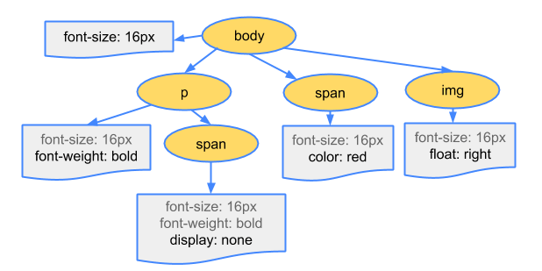
CSS Parsing
On Encountering a Link Tag:
On encountering a “link” tag:
A request is dispatched to load CSS file
Parser parses the style file
Parser converts CSS into CSSOM
CSSOM resembles a tree like structure

Slide 7
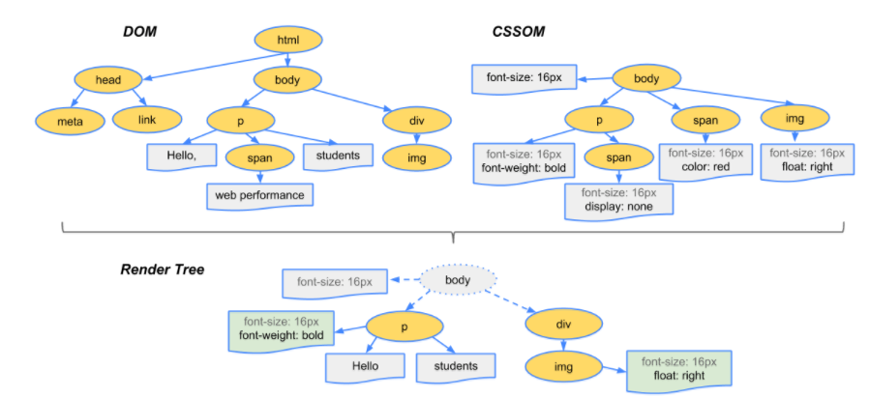
Render Tree

Slide 8
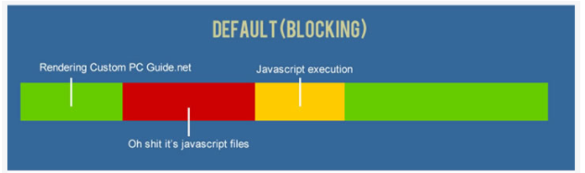
How JavaScript is Executed
On encountering a script tag, browser stops parsing of HTML file.
If Script is an external file, request to the network is dispatched to load the script file.
Once the script is loaded, it starts executing.
While the script is executed, the parser further render DOM elements.
Once the script execution stops, further parsing of DOM elements resumes.

Slide 9
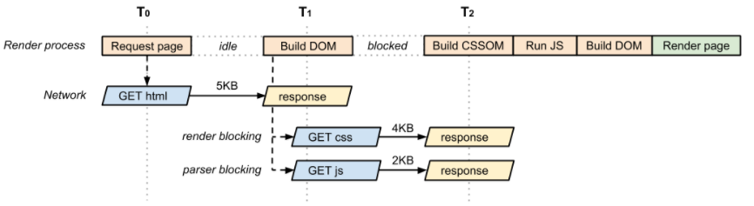
Blocking Scripts
Browser waits for Scripts to finish loading and execution before it could render the page

Slide 10
Problems with Large Applications

Slide 11
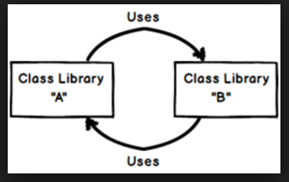
Problems while Developing Large Scale Applications
Large Code Base often leads to less Modularised structure
Including Multiple Libraries and Script file in an Application
Unmanaged and Circular Dependencies
Polluted Global Namespaces
Unmanaged Browser Memory
Large amount of network calls to load dynamic scripts and resources
Ensuring that Scripts and resources are loaded effectively

Slide 12
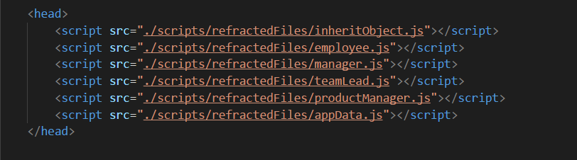
Loading Multiple JavaScript
Developer need to explicitly maintain the order in which scripts have to be loaded.
Loading the script in incorrect order may introduce inconsistencies and errors

Slide 13
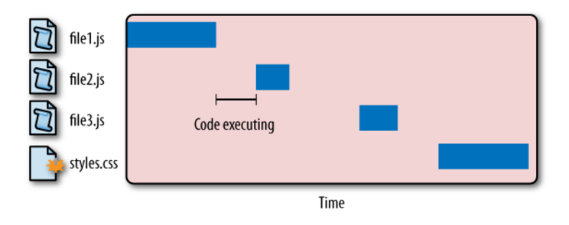
Loading and Execution of Multiple Scripts

Slide 14
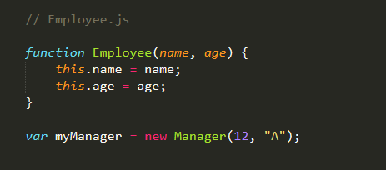
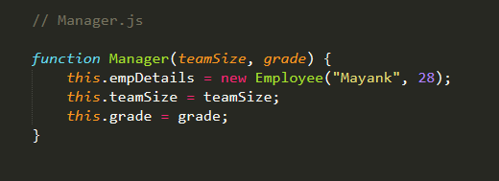
Unmanaged Dependencies:
The above files are dependent on each other.
For “Employee.js”, we need to have “Manager” which is defined in “Manager.js”
For “Manager.js” to execute, we need to have “Employee” constructor function defined in “Employee.js”
These files are interdependent on each other.

Slide 15
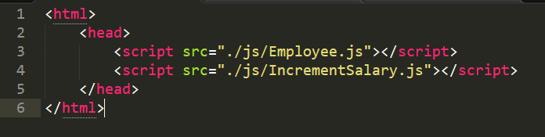
Managing Dependencies
Script files may be Dependent on other script files.
“IncrementSalary” is dependent on “Employee.js”.
Need to ensure that “Employee.js” is loaded first.
Dependencies need to be managed in order to ensure that the application works fine.
In a large Application, there are 100s of script file, therefore managing dependency is difficult

Slide 16
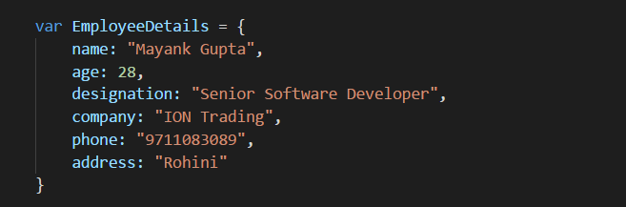
Polluting Global Scopes
There might be several variables storing intermediate values.
If not managed properly, these values might be added to the global scope.
As more and more global variables are added, there might be higher chances of inconsistency
Browser have limited amount of memory.
Global Scope Pollution should be avoided.

Slide 17
Loading Unnecessary Script Files
Application may load all the Available Script files at once.
Scenario:
There might be multiple script files in an Application.
Each Script File accomplish a specific task
User of the Application may not perform all the tasks
Scripts are loaded unnecessarily.
Loading more scripts require Network Bandwidth
Slows down the Application
Increase Browser Load

Slide 18
Chrome Developer Tools

Slide 19
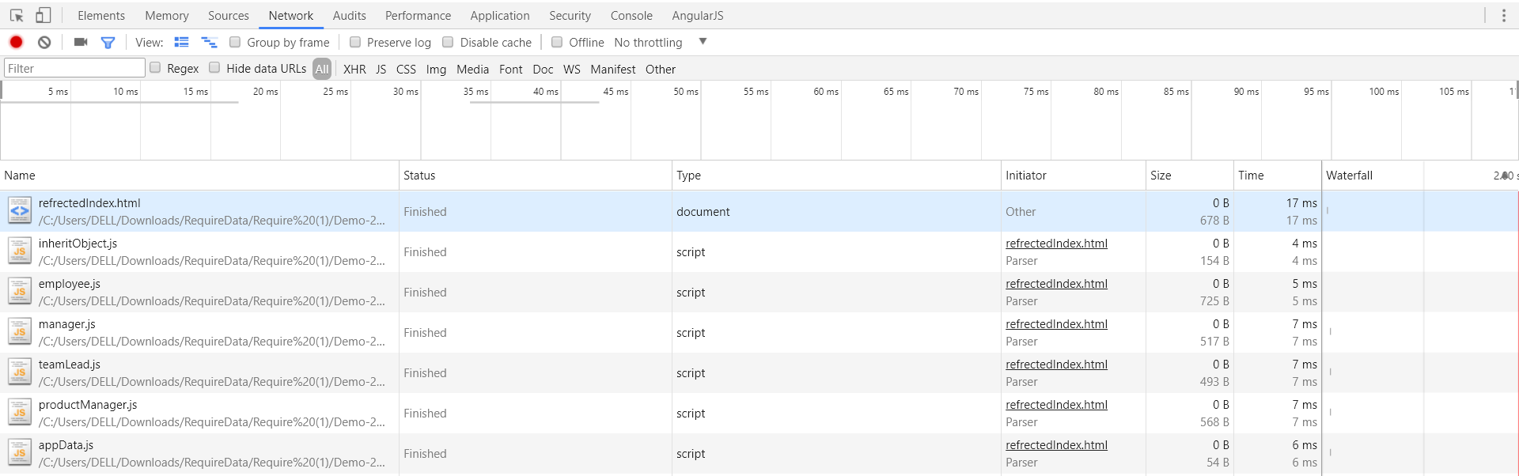
Network Tab

Slide 20
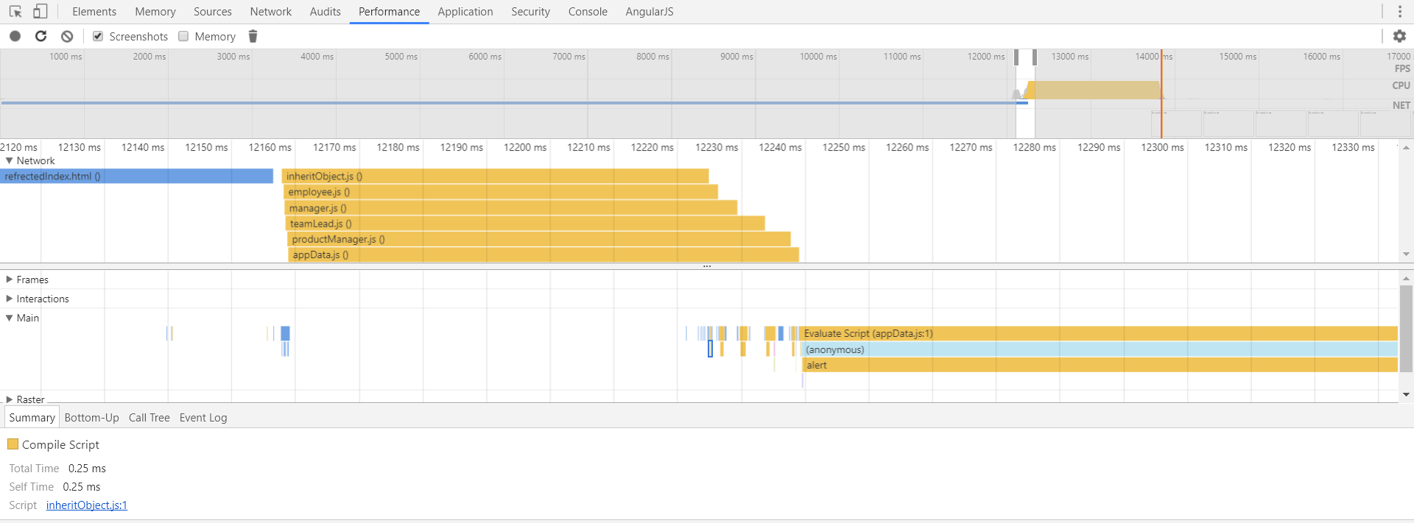
Performance Tab

Slide 21
Resolving Problems using “Async” & “Defer”

Slide 22
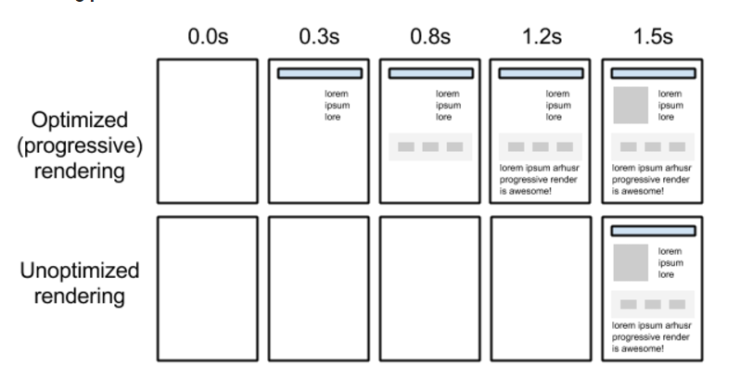
Progressive Loading

Slide 23
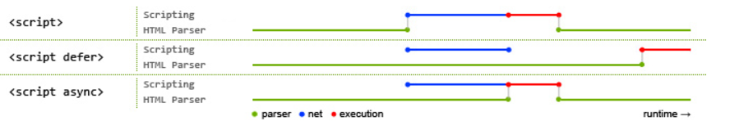
Loading Files Asynchronously
There are alternates to load files asynchronously:
Defer
Async
Both async and defer scripts begin to download immediately without pausing the parser

Slide 24

Using Async
Async allows following:
Make par­al­lel requests to fetch the files.
Con­tinue pars­ing the doc­u­ment as if it was never interrupted.
Exe­cute the indi­vid­ual scripts the moment the files are downloaded

Slide 25
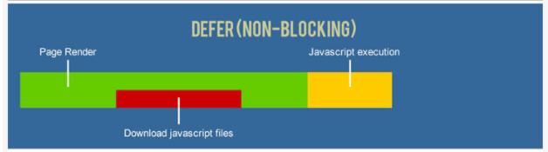
Using Defer
Defer allows the following:
Make par­al­lel requests to fetch the indi­vid­ual files.
Con­tinue pars­ing the doc­u­ment as if it was never interrupted.
Fin­ish pars­ing the doc­u­ment even if the script files have downloaded.
Exe­cute each script in the order they were encoun­tered in the document

Slide 26
Problem with Async and Defer
Async Cannot ensure the order of execution of scripts
Async Cannot ensure Order of Loading of Scripts
Defer need to ensure the order of Script Loading

Slide 27
Browser Optimisations

Slide 28
As a part of optimisations done by the browser:
Parser look for all the script and style files included in the html page
Request for Script and Style Files are sent on network
Increase the speed since parser is not waiting for file to download first and then execute it

Slide 29
JavaScript Design Pattern

Slide 30
Modular Code Structure
Dividing a software system into smaller and maintainable modules.
Each building block of a system should have only a single responsibility
Much better to have a single class/object that has responsibility over a single part of the functionality
System elements should have exclusivity and singularity of purpose
Logical or physical constraint which delineates a given set of responsibilities.
Enables system to have reusable components.
Eliminate the duplication of functionality.
Restrict the scope of work to a maintainable size.

Slide 31
Module Pattern
Module Pattern is used in case:
Provide Modularized Code Structure
Providing Single Responsibility to each Module
Provide Implementation for Public and Private Encapsulation
Create Usable and Maintainable Code
Based on IIFE (Immediately Invoked Function Expression)
Create a separate scope for the execution
Object, Functions and Properties are exposed from the Scope Created

Slide 32
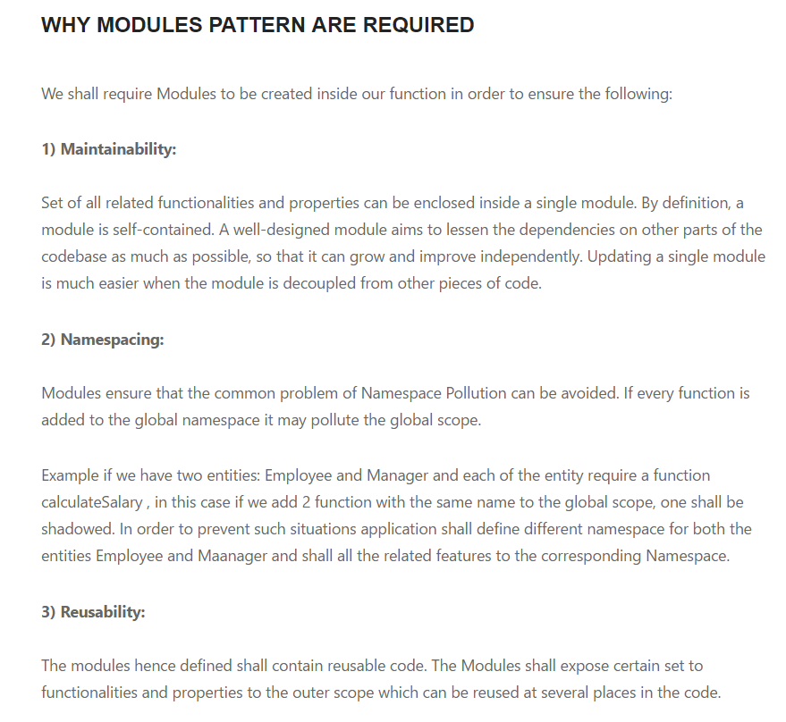

Slide 33
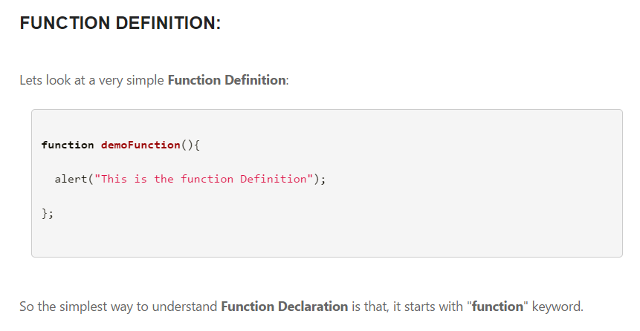

Slide 34
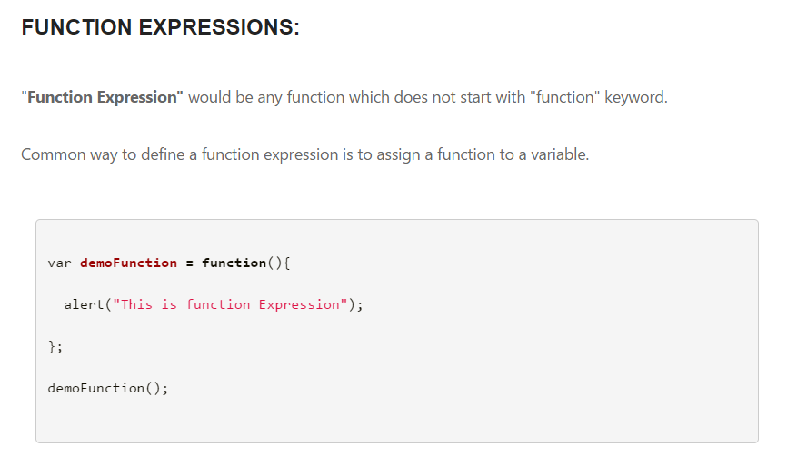

Slide 35
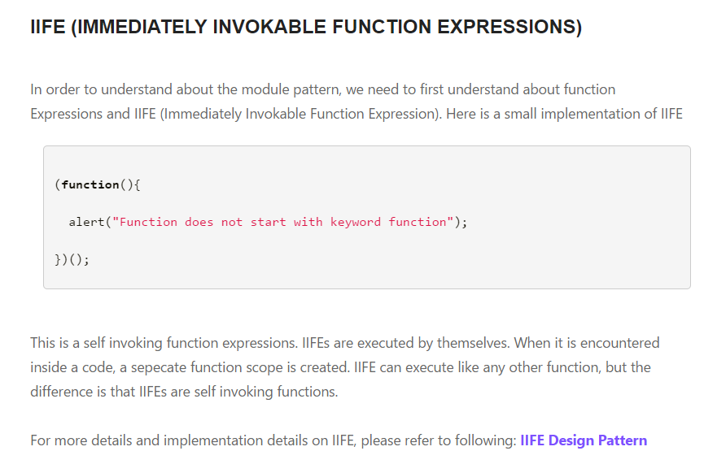

Slide 36
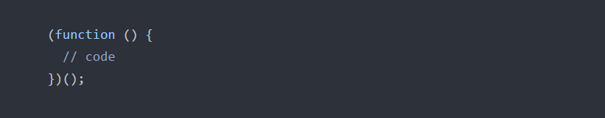
Understanding Module Pattern
Creating an IIFE
IIFE stands for Immediately Executable function Expression.
It consists of creating an anonymous function and self invoking the function.
IIFE creates a separate scope and wraps all the implementation in that scope
It further Exposes only the code which is required outside. IIFE represents a scope.

Slide 37
Creating an IIFE..
When a function expression is created:
A new scope is created for the expression
Anything declared inside this scope, will be limited to function expression
Once the function expression finishes execution, scope is destroyed
If function expression returns data, scope is retained
Function Expressions do not pollute global scope.

Slide 38
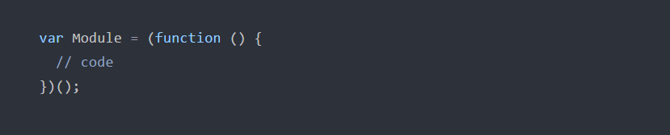
Creating Module using IIFE
Further, the newly created scope is namespaced to access any returned function or Objects.
The newly created scope is namespaced a “Module”.
We can add Methods and Properties to be exposed to Global Scope using Module

Slide 39
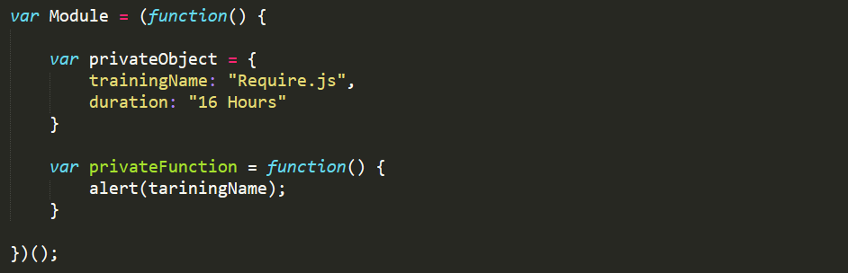
Adding Private Properties to Module
Adding Private Properties to Module
We can process data inside Module
Private member can be added to the Module

Slide 40
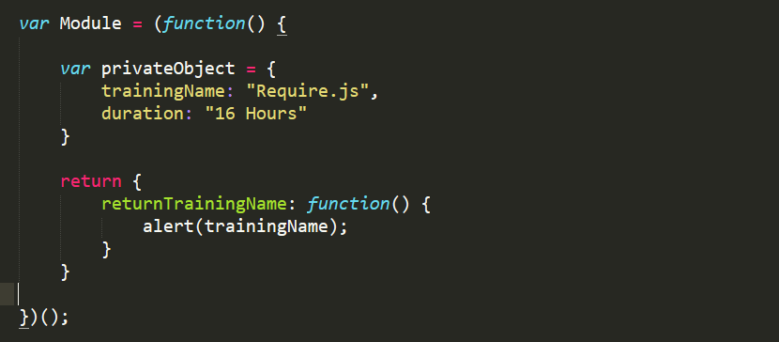
Exposing Public Functions from Module
Exposing Functions and Properties from IIFE:
The properties can be exposed from IIFE, using “return” keyword
The properties returned from IIFE are exposed to the Global Scope

Slide 41
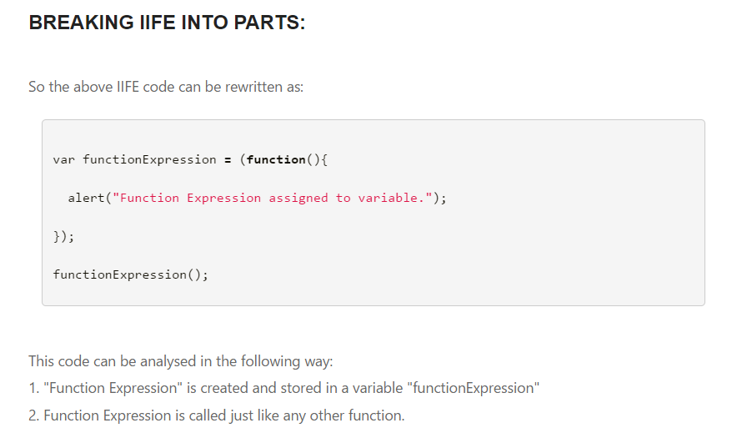

Slide 42
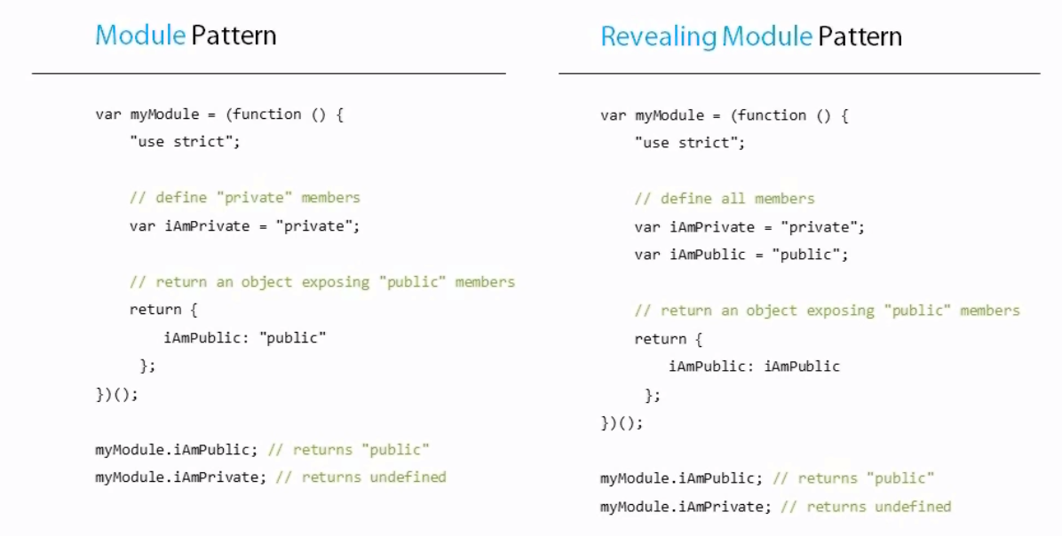
Module Pattern

Slide 43
What Require.js Help to Conquer

Slide 44
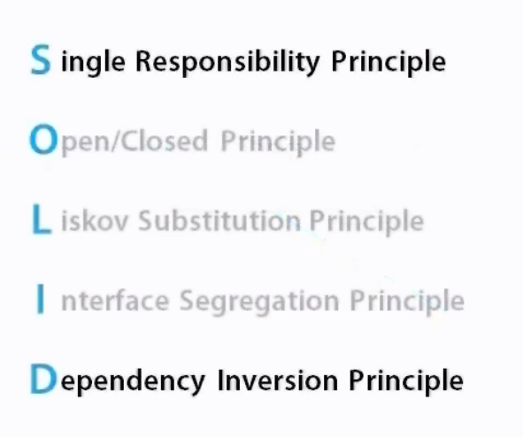

Slide 45

Single Responsibility Principle

Slide 46
Single Responsibility Principle
Every module or class should have responsibility over a single part of the functionality
Responsibility should be entirely encapsulated by the class
Module should have one, and only one, reason to be changed
Two aspects of the problem are really two separate responsibilities
It Helps to achieve
Organised Code
Less Fragile Script Files
Less Coupling
Unit Testable
Maintainable
Makes Life of Developer easy

Slide 47
Dependency Injection and Management
Dependency Injection is a technique whereby one object supplies the dependencies of another object
An injection is the passing of a dependency to a dependent object that would use it
A third party script is involved in managing the dependencies
Scripts at runtime specifies their dependency to the external module
This External Modules look for the dependent files and loads them
Once the dependent files are loaded, it executes.
The dependency is then fed to the requesting script files
File Load is Deferred until it is Required

Slide 48
Using Require.js

Slide 49
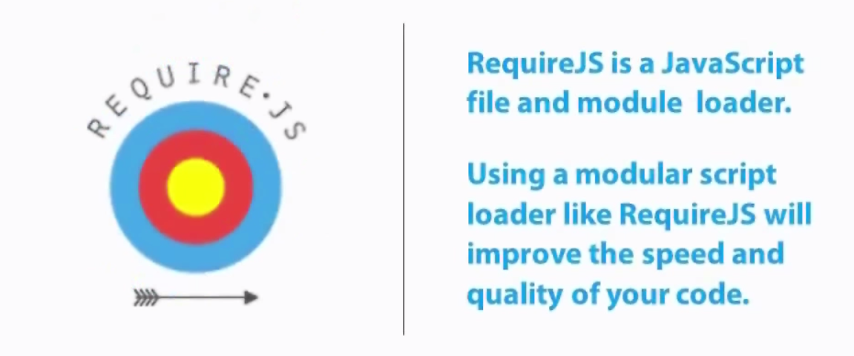
What is Require.js

Slide 50
What are AMD Modules
AMD Stands for Asynchronous Module Definition
Proposed API Definition for loading scripts asynchronously
Require.js is AMD Module
Require.js implements API exposed by AMD Definitions
Why is AMD Required ?
Performance (Async enhances the Performance)
Modular (Modular Implementation of Code)
Reduce Global Variable
Maintain Dependency
Encapsulate Code in smaller, more logically organised files

Slide 51
What is Require.js ?
Require.js is a JavaScript Module
Primarily used as a Module Loader
Implements Asynchronous Module Definition
Why Require.js
Optimize Loading of Static Resources
Also Works with other languages like Rhino and Node.js
Dependency Injection and Dependency Management
Using RequireJS makes code more Simpler and Modularized
Enhance Speed and Quality of Code
Each Module handler a Single Responsibility

Slide 52
Why Require.js ..
It provides us with the Mechanism to load files concurrently
Created Modules which contains set of related functions
Lazy Loading of files when required.
Helps to Optimise the Script loading.
Asynchronous Loading
Parallel Loading
Loads Script asynchronously and Maintains Order

Slide 53
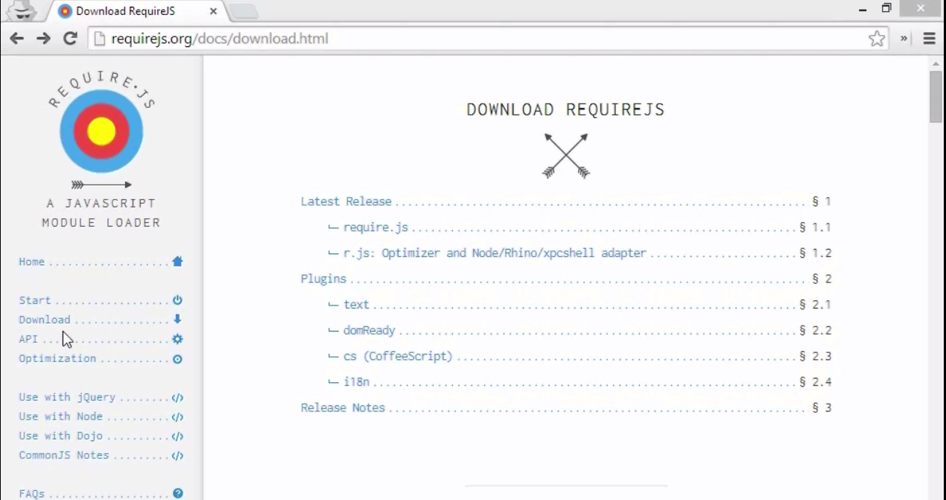
Require.js

Slide 54
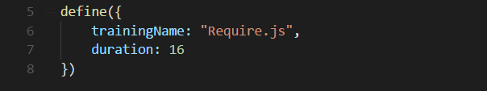
Defining a Simple Module using Require.js
“Define” keyword is used to define a require module.
The Object literal specifies the properties to be exposed from the Module.
The Specified module can be loaded using “Require” Keyword.

Slide 55
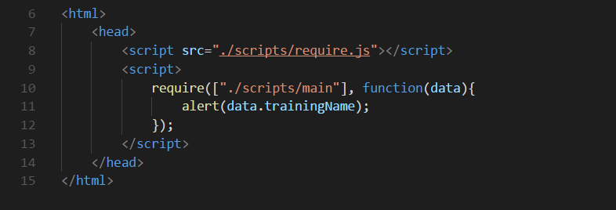
Including Require.js Module
Module can be loaded using “Require” keyword.
We need not to specify “.js” while including a script file
By default “Require.js” look for the file with same name and “.js” extension

Slide 56
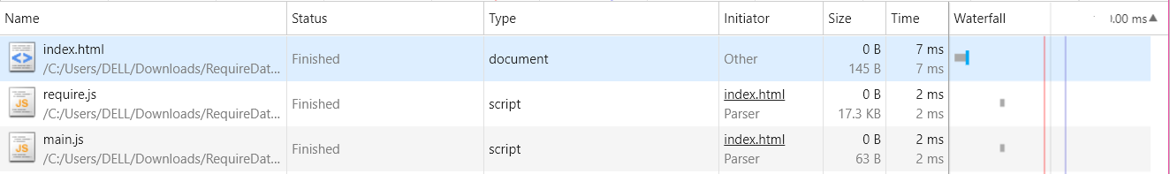
Network Call without Require.js
When we are not using “Require.js”
The request to load script files are handled by the Parser
Loading script using Parser, loads it in synchronous manner.

Slide 57
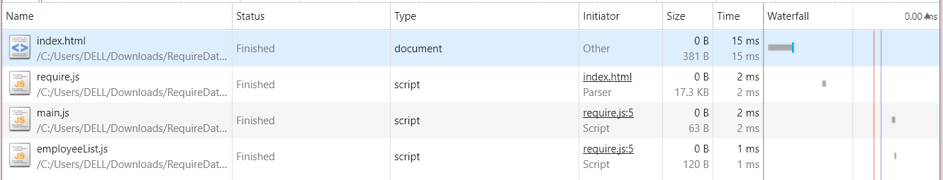
Using Require.js to Load Scripts
Using Require.js to load script:
Script are loaded by Require.js Library
Scripts are Loaded Asynchronously.

Slide 58
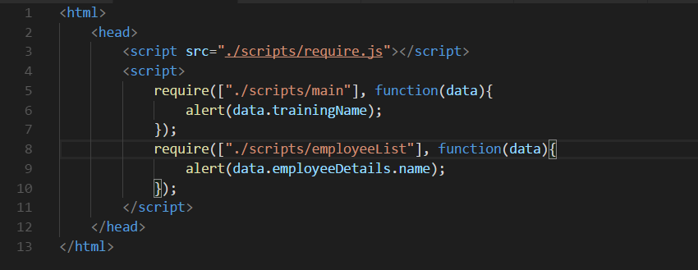
Application with Multiple Entry Points
This method is basically used when:
Application has multiple Entry Points
File Dependencies are independent of each other.

Slide 59
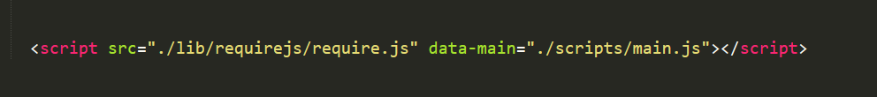
Application with Single Entry Point
“Data-main” is a special attribute that “require.js” will check to Start Script Loading
“data-main” is Intended for use when the Page just has One Main Entry Point
“main.js”Usually used to Set Up Configuration Options and Initialize First Application Module
“main.js” is used to include other Scripts
“main.js”Used to define initial dependency between the Modules

Slide 60
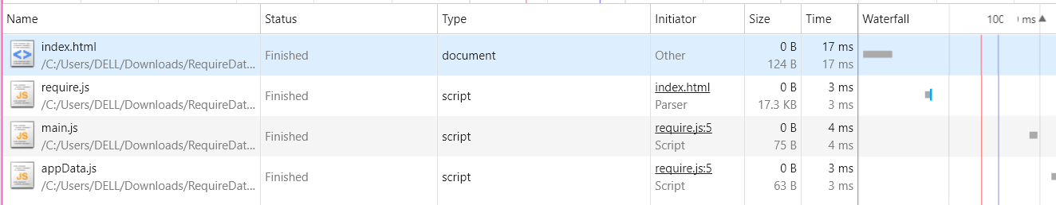
Specify Main File to Require.js

Slide 61
Defining Modules using Require.js

Slide 62
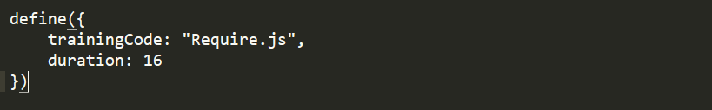
Defining Modules
Simple Name/Value Pair:
If the module do not have any dependencies
Values to be exposed are just collection of “name/value” pair
Can be defined using String Literal
The module shall be exposing a “String Literal” with defined properties
Requiring this module shall make these “Name/Value” pair available to other modules

Slide 63
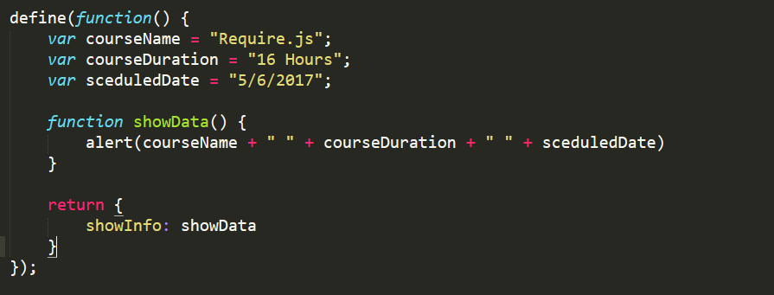
Defining Modules..
2. Defining Functions
Module with no dependency
We need to perform some preprocessing before returning Object

Slide 64
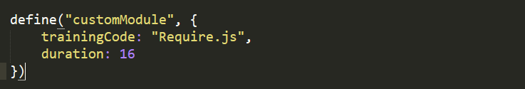
Defining Modules..
3. Defining Modules with Name
Module with No dependencies
We need to define the name for the module
Module need to return a simple Name Value Pair
No Preprocessing need to be done.

Slide 65
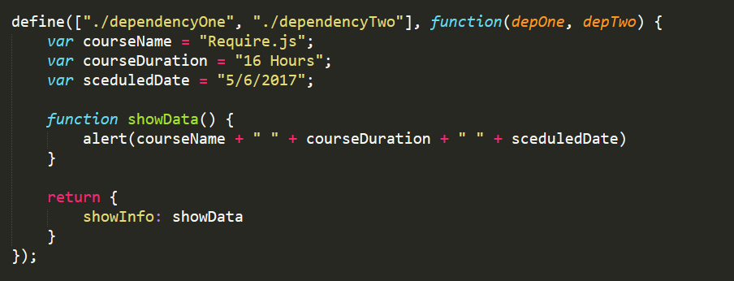
Define Modules..
4. Defining Modules with Dependency
Specify the dependency of the Module on other modules

Slide 66
Defining a Module..
Managing Dependencies:
When dependencies are specified:
It specifies the Modules on which the current code is dependent
Require.js ensures that the required modules are loaded first
Once Require.js encounters a dependent code
A request is triggered to the network for the resource.
The requested module is loaded.
Once the requested modules are loaded, the script executes the dependency
The script return the data from the dependent script

Slide 67
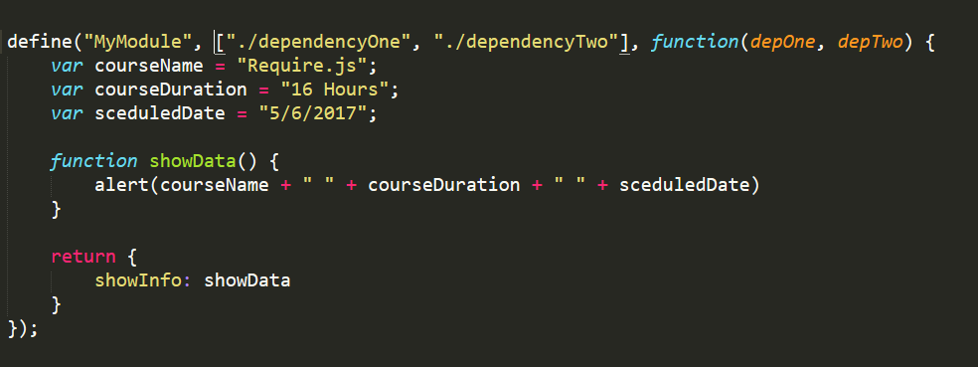
Defining Modules..
5. Defining Modules with Name
We explicitly define name for the module created.
Other modules can load this module specifying the name instead of file path

Slide 68
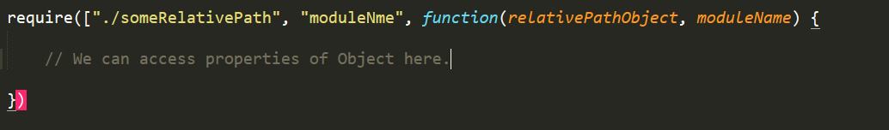
Requiring Modules
The Modules created can be loaded in another module
Modules can be loaded using:
Relative Path
Specified Module Name

Slide 69
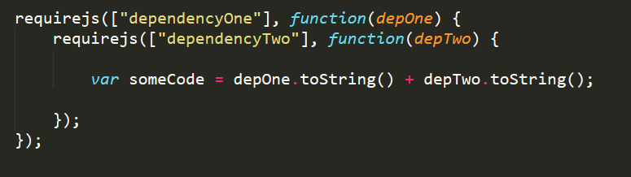
Adding Hierarchical Dependencies
Multiple dependencies can be added in Hierarchical Manner
Script can specify further Dependencies once the Parent Dependency is Resolved
“”dependencyTwo” is loaded once the “dependencyOne” module is loaded
Application can have multiple level of dependencies

Slide 70
Difference b/w Require and Define
Define is used when:
User need to expose a New Module
When Module need to export Object from itself
Require is used when:
User need not to expose a new Module
Existing Module are used.
When set of Existing Modules is needed to be integrated
When existing Modules combine to bring a bigger functionality

Slide 71
Require.js Optimization Method
Once the JavaScript Module is loaded, using Require.js
Require.js Caches the Module
Whenever there is a request for a Module, Require.js looks for the module in cache
If the Module is not found in cache, request for the module is sent
Once the Module is received from the network, it is cached
If the Module is found in Cache, the Module is returned from cache.
Hence Require.js manages Optimisation, by caching the Module
Also the Circular Dependencies are managed by the following manner.

Slide 72
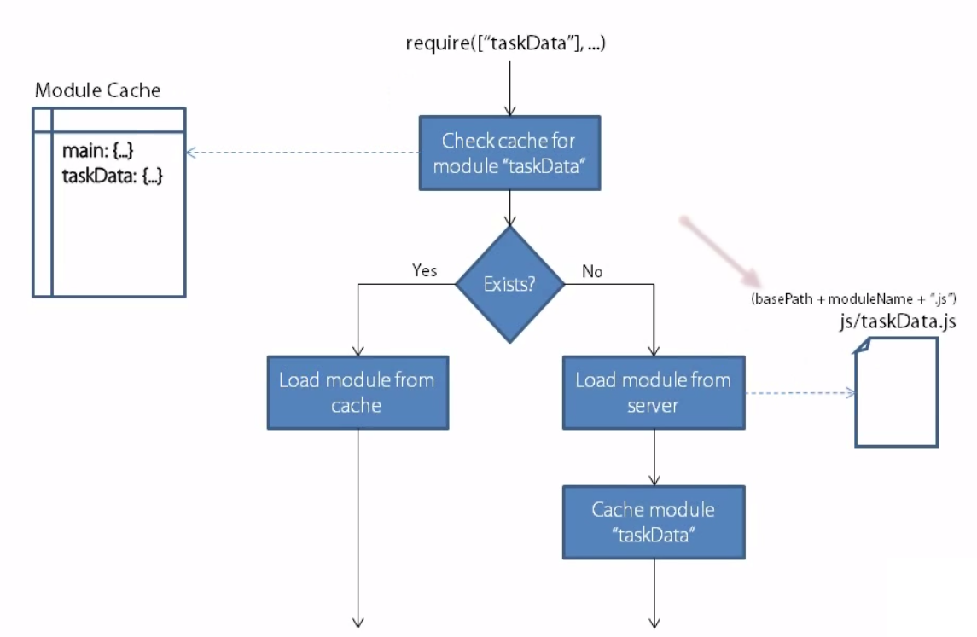
Require.js Optimization Method.

Slide 73
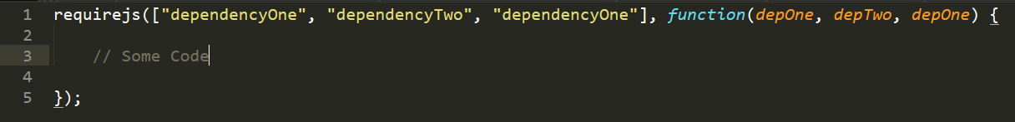
Require.js Optimization Method..
If the Module is already loaded, Require.js would cache the Module
No request would be sent for the Modules that are already Cached in the Require.js
In the above code, “depOne” will be loaded just once. Next time Cached version would be sent
In the following Manner, Require.js manages the optimization over the network calls

Slide 74
Solving Existing Problems using Require.js

Slide 75
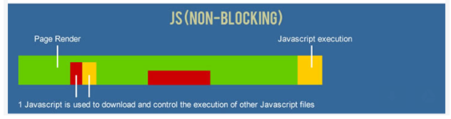
How Require.js Resolves the Issue
Require.js allows the following:
Make par­al­lel requests to fetch the main file.
Execute the main javascript file to find dependencies
Con­tinue pars­ing the doc­u­ment.
Load dependent script file asynchronously
Fin­ish pars­ing the doc­u­ment even if the script files have downloaded.
Exe­cute each script dependent script

Slide 76
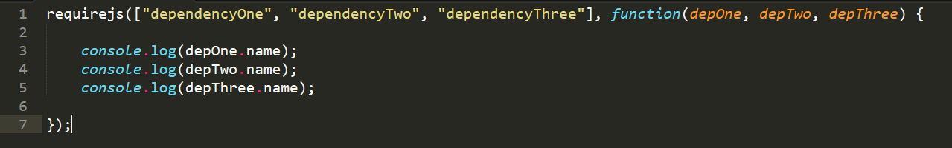
Problem of Asynchronous Loading
Require.js can be configured to Load Multiple Script Files Asynchronously
We can specify the modules which are required to load Asynchronously in the Application
Module are loaded Asynchronously, but they are executed sequentially
Sequence is always maintained
Script files are asynchronously Loading, but do not interrupts Parser execution

Slide 77
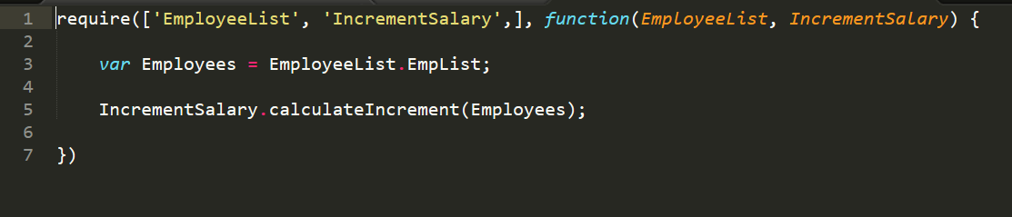
Problem of Dependency Management
Dependencies to be loaded can be specified
Dependent Modules can be loaded in Asynchronous manner, but they execute sequentially
All the modules are loaded before execution of inner code in “main.js” file

Slide 78

Problem of Dependency Management..
The Dependency can also be resolved by specifying in form of Hierarchy

Slide 79

Problem of Dependency Injection
There might be scenario where we have conditional requirement for a module.

Slide 80
Other Module Loader Available
Other Commonly Used Module loaders are:
Common.js
ES6 Modules

Slide 81
Common.js Module Loader
Define a series of specifications to help in the development of server-side JavaScript applications
Node.js developers originally intended to follow the CommonJS specification
Allow files to be loaded Synchronously
Major Downside of Common.js:
Synchronous API makes it not suitable for certain uses
One File per Module (Cannot have multiple module in a file)

Slide 82

Common.js Implementation

Slide 83
ES6 Module
Uses “export” and “import” for modules
Synch and Asynch Loading Supported
Syntactically Simple
No need to import any separate libraries
Major DrawBack:
Still not supported in majority of Browsers

Slide 84

ES6 Module Implementation:

Slide 85
Configuring Require.js

Slide 86
Configuring Require.js
Require.js can be configured in “main.js” file
We have different options available for configuring Require.js
BaseUrl
Paths
Shim
Config
WaitSecond
Deps and Callback
UrlArgs

Slide 87

Configuring Require.js
The First file loaded using “data-main” can be used to configure Require.js
The configuration should be placed on the top before specifying any dependencies

Slide 88

Configuring Require.js..
BaseUrl: Used to set the Base path for the Application
Any Static resource to be loaded, shall first look for the base path
Once the base path is read, the module location is calculated accordingly.
Used to configure the base path of the Application
The Scripts are then loaded relative to the Base Path
In the Image below, the basePath is set as “js” folder, so any path specified will be relative to “js” folder

Slide 89

BaseUrl..
** Note: Either one of the situation hold valid, precedence is given to the data-main attribute

Slide 90

“Path” Configuration
Used to set up “path” for the scripts
“Path” can be seen as an alias for the relative file path
Now we can access “jquery-2.1.1.min.js” with the alias name “jquery”
We can configure complex paths in “path” attribute.

Slide 91
Configuring Require.js..
3. Shim:
Depend on 3rd Party Library that do not registers with Require by its own
Library like “Underscore” do not registers with Require
When “Underscore” is added to the page, it registers “_” variable of Global scope to be Underscore Library
Require pull the underscore dependency from global scope
“Exports” matches to the property in the “Global Scope”
The Global scope properties will now be referred as value provided in “exports”.
We can also define the dependency using “deps” attribute

Slide 92

Configuring Require.js

Slide 93

Configuring Require.js..
4. Config Option
This is used to define Global Configuration
These Global Configuration can be used in any require.js Module

Slide 94

Configuring Require ..
5. waitSeconds:
Wait for number of seconds to wait before throwing Timeout Error
Module Loading is Asynchronous
If the script is taking time to load, it will send a timeout error.

Slide 95

Configuring Require..
6. Deps and Callback
Deps specifies the list of dependent modules to be loaded as soon as Require.js is loaded in the system
Callback specifies the callback function that need to be invoked once the dependencies has finished loading.

Slide 96

Configuring Require..
7. urlArgs:
Provide extra string argument is appended to the URLs that Require used to fetch resources

Slide 97

What are Require.js Plugins

Slide 98

Supported Plugins..

Slide 99
Text Plugins..
Usually require loads only javascript files
These JavaScript files are executed as soon as they are downloaded
Text Plugins:
Loads files as Plain Text
Return text as string to the module

